Slide 1

Osmany Hall Messing System
GROUP - 6
Notes:
We designed this template so that each member of the project team has a set of slides with its own theme. Members, here’s how you add a new slide to just your set:
Mark where you want to add the slide: Select an existing one in the Thumbnails pane, click the New Slide button, then choose a layout. The new slide gets the same theme as the other slides in your set.
Careful! Don’t annoy your fellow presenters by accidentally changing their themes. That can happen if you choose a different theme from the Design tab, which changes all of the slides in the presentation to that look.

Slide 2
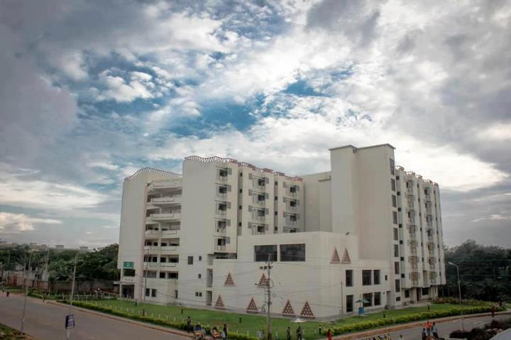

Slide 3

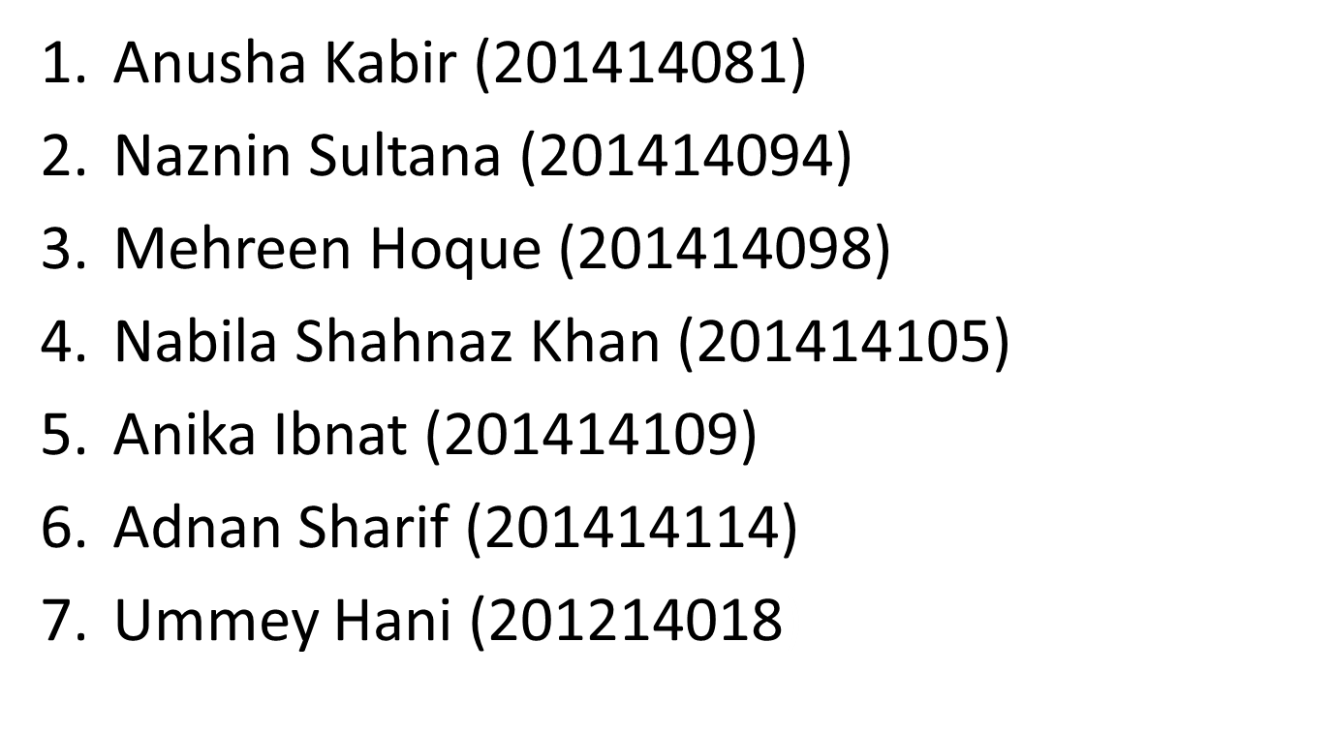
Group Members

Slide 4
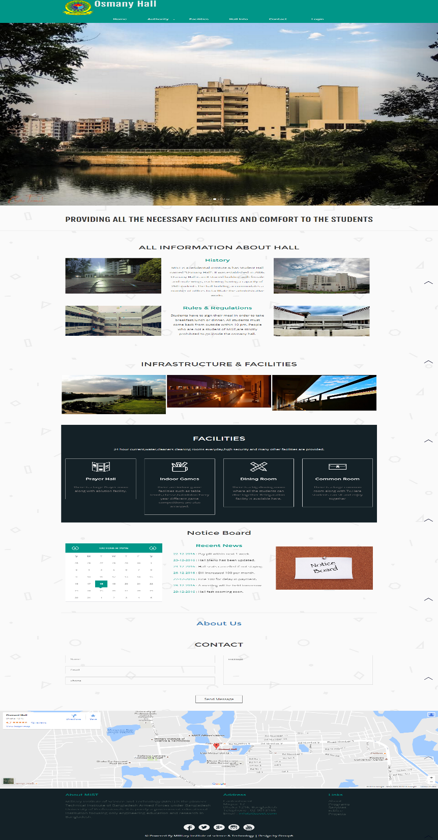
Home page of website
of Osmany Hall Messing
System which will provide
history , rules and
Regulations , facilities
and infrastructure
of Osmany Hall.
Moreover, recent news and
notices will be
flashed here.

Slide 5
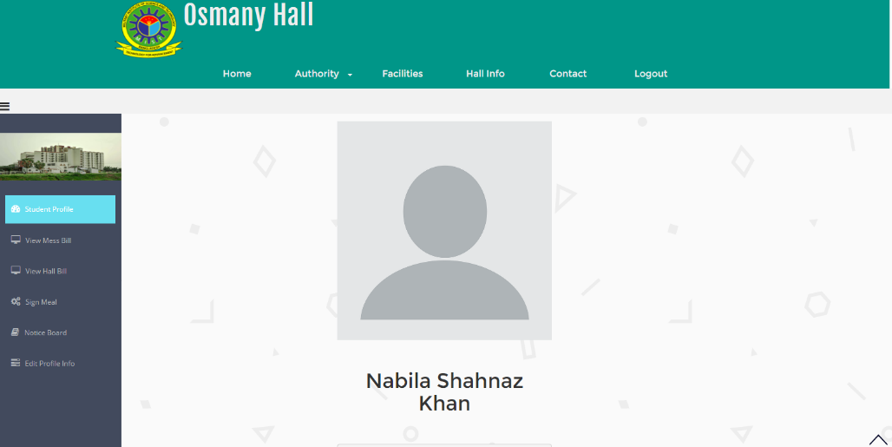
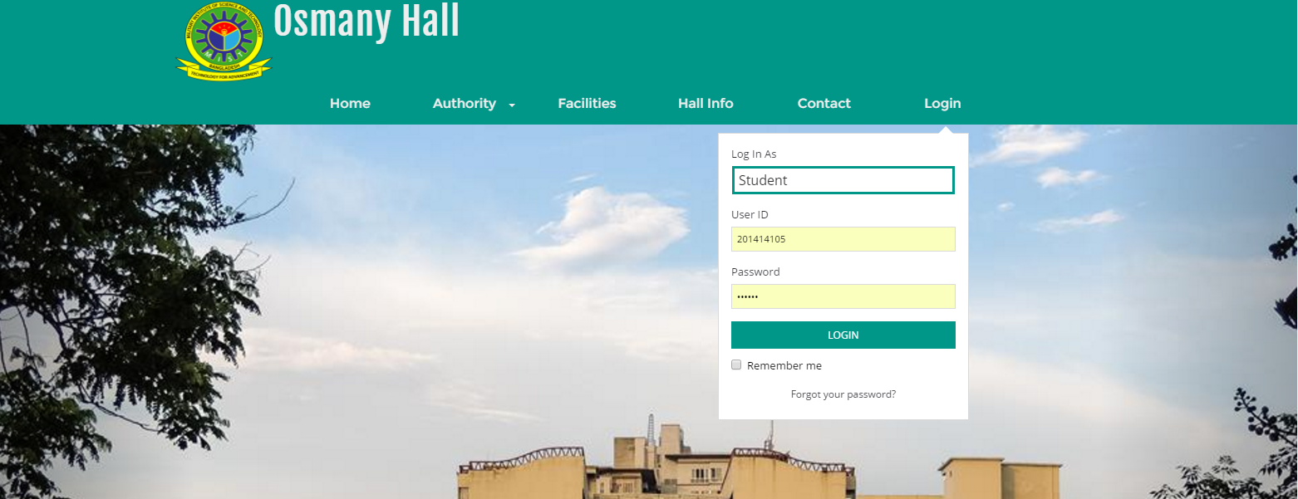
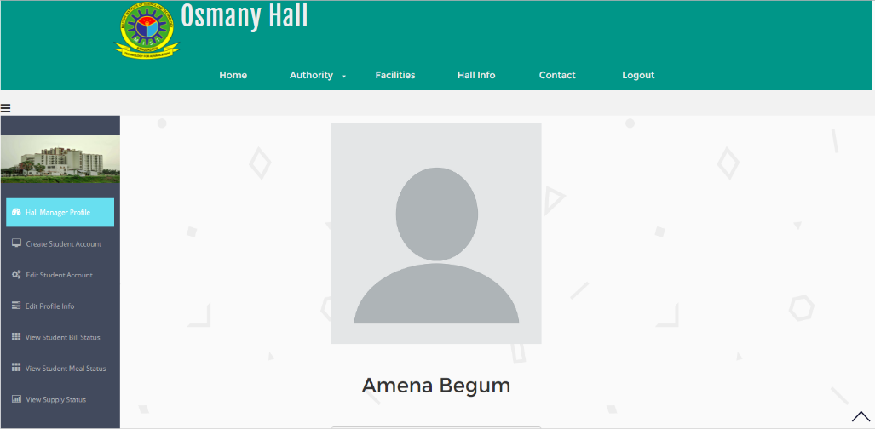
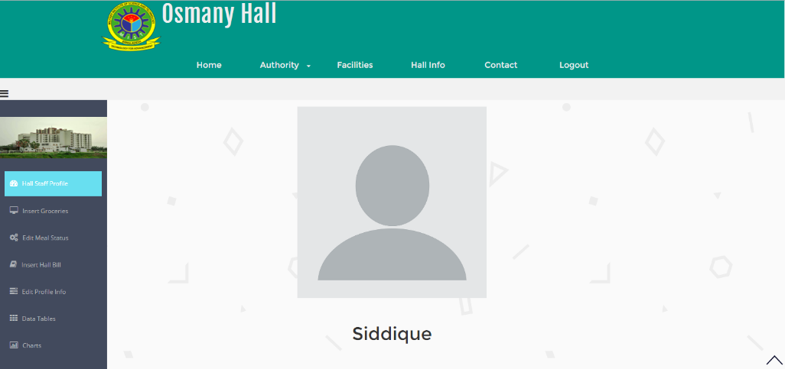
Home page to different profile pages transition

Slide 6
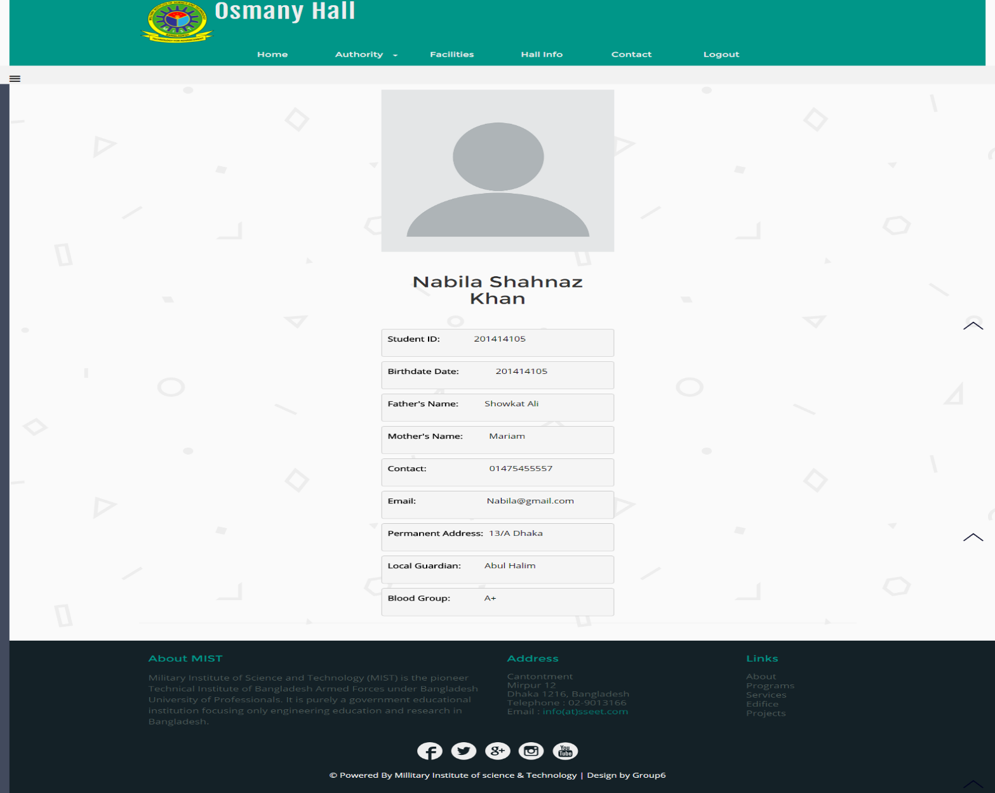
Students profile

Slide 7
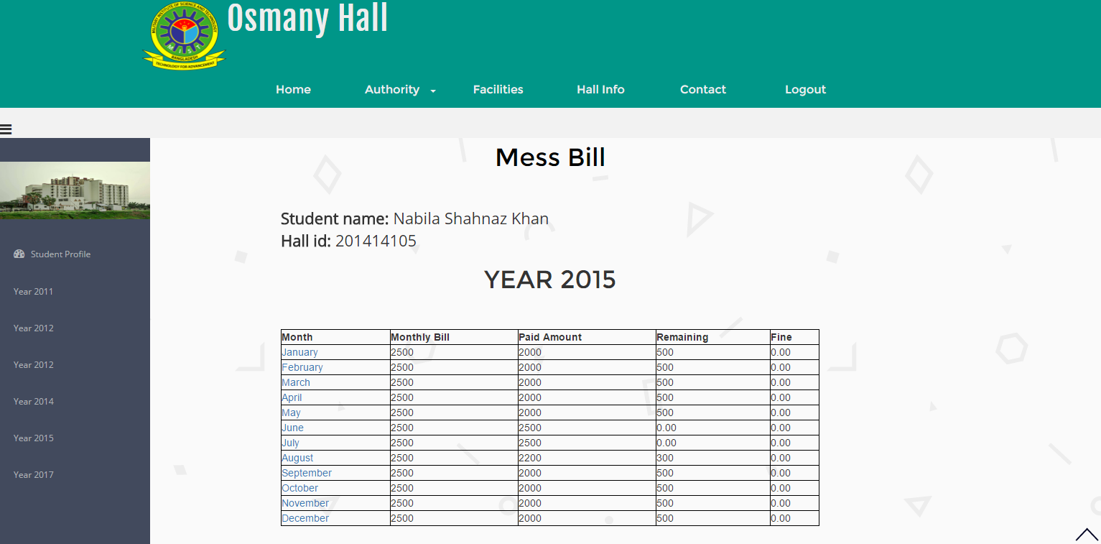

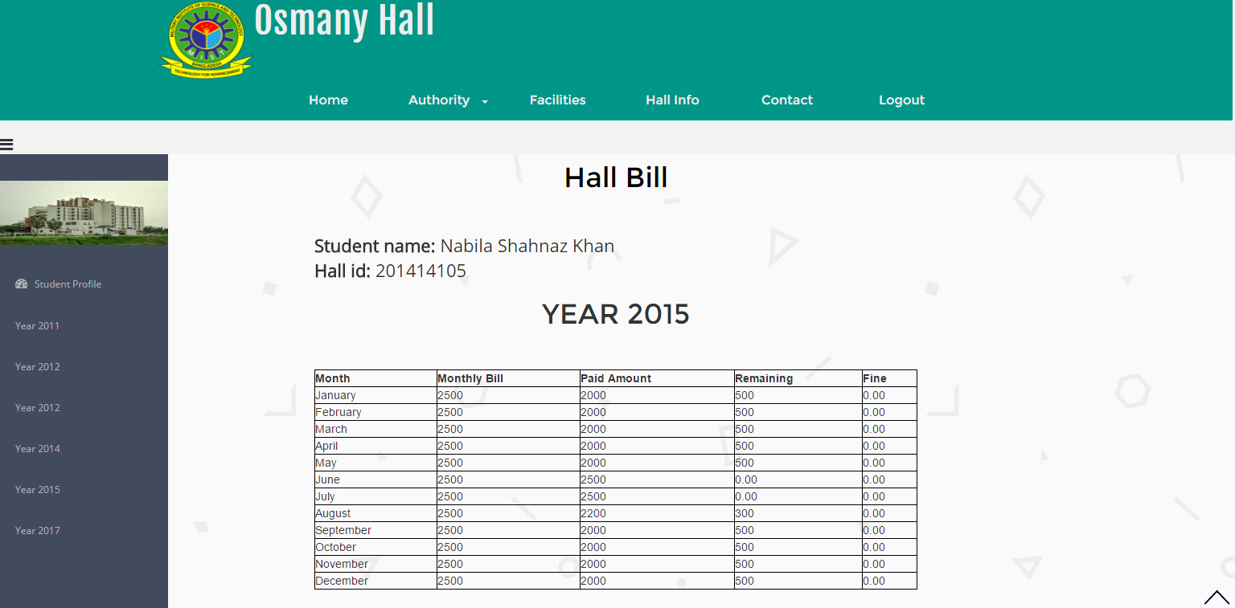
From students account to view mess bill and hall bill pages transition

Slide 8
Student can see mess bill of particular year

Slide 9
Student can see hall bill of particular year

Slide 10

Manager’s profile

Slide 11

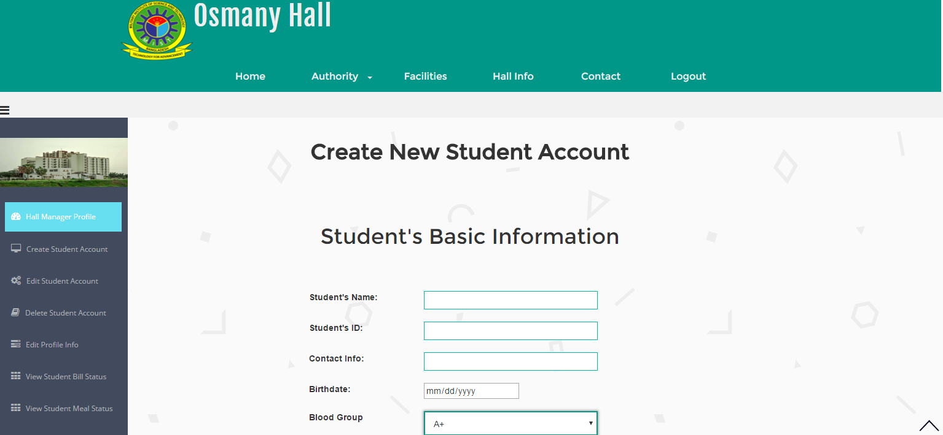
From hall managers profile to create student account transition

Slide 12
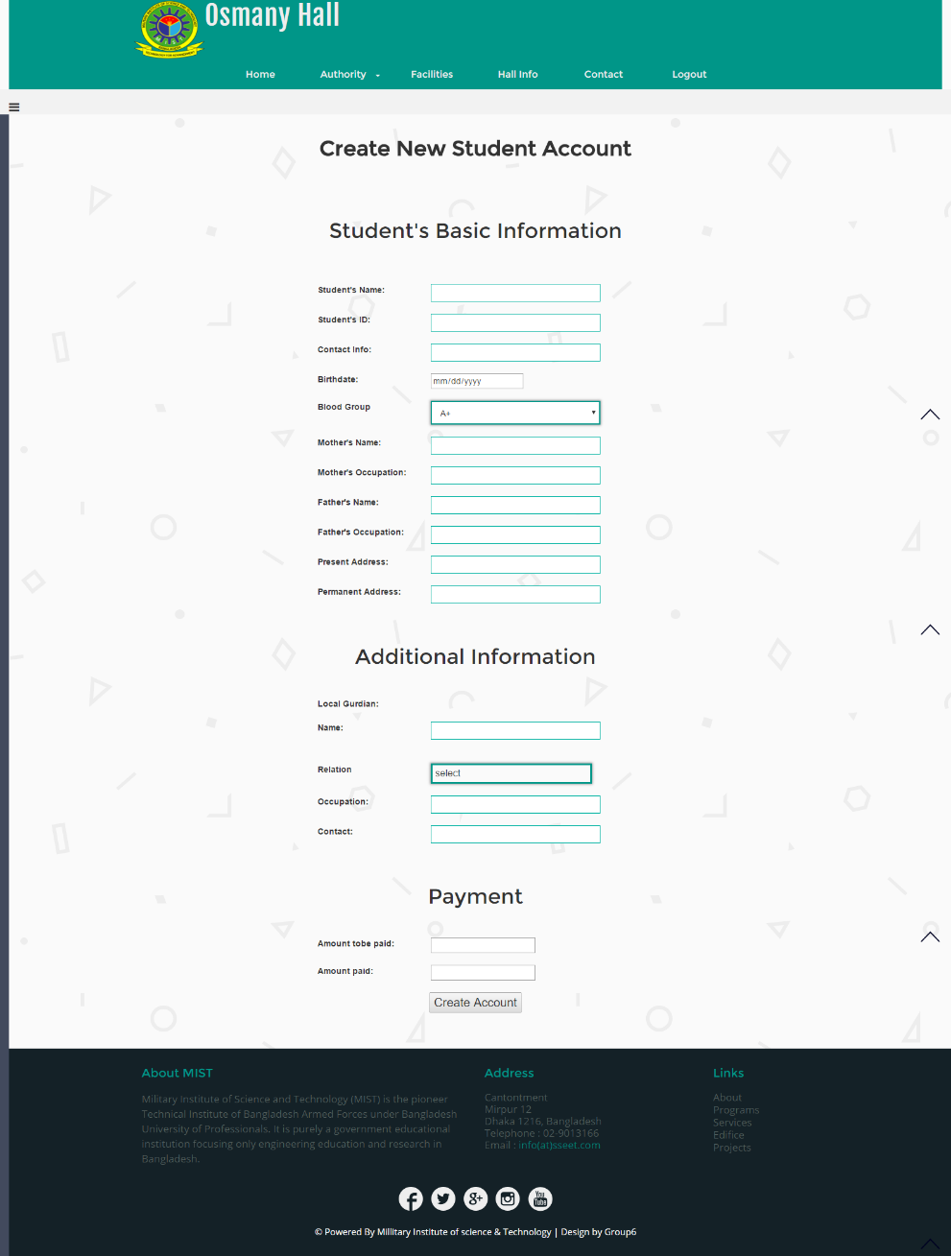
Hall manager profile with create student account option

Slide 13


Hall staff’s profile
With navigation bar
Without navigation bar

Slide 14
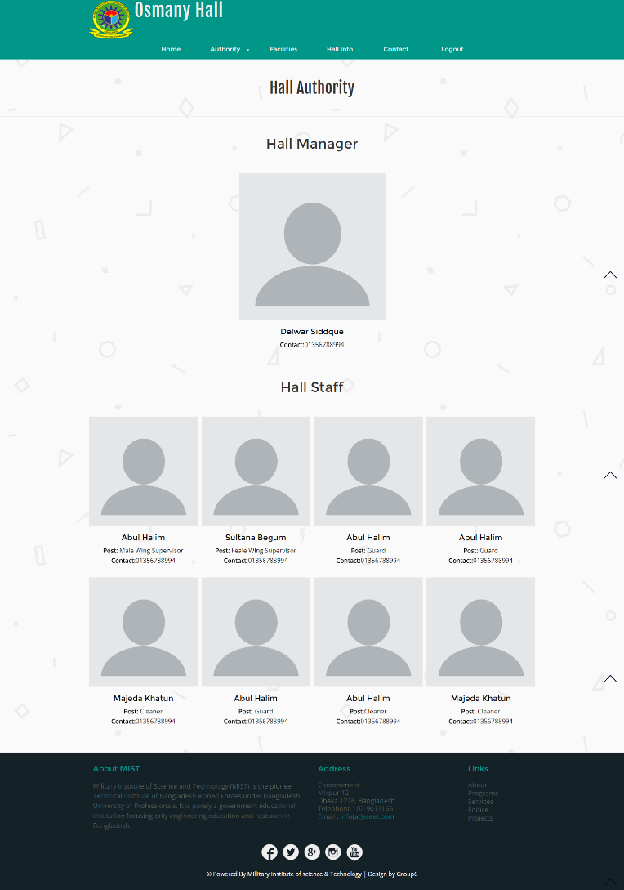
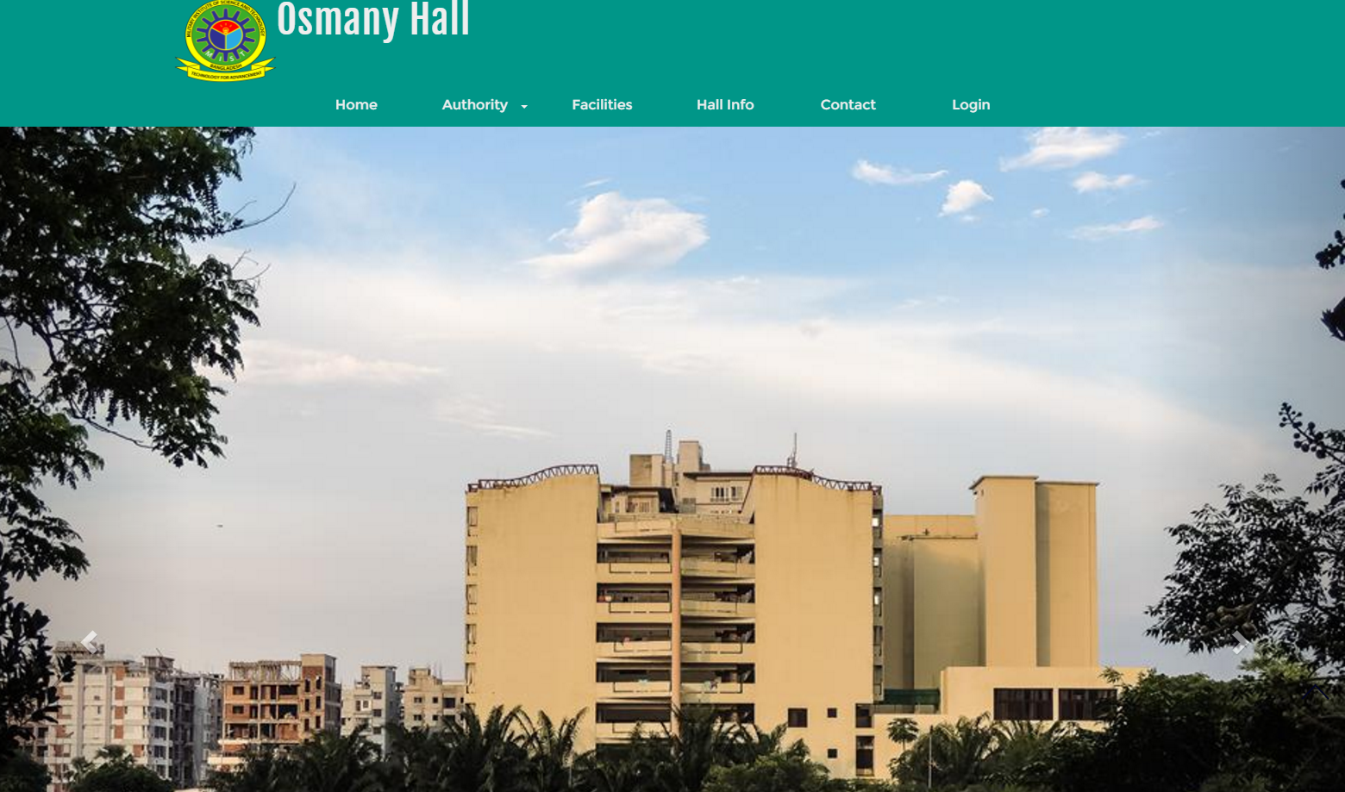
From home page to authority page transition

Slide 15
The webpage contains names and contact information of
hall manager and other hall staffs.

Slide 16
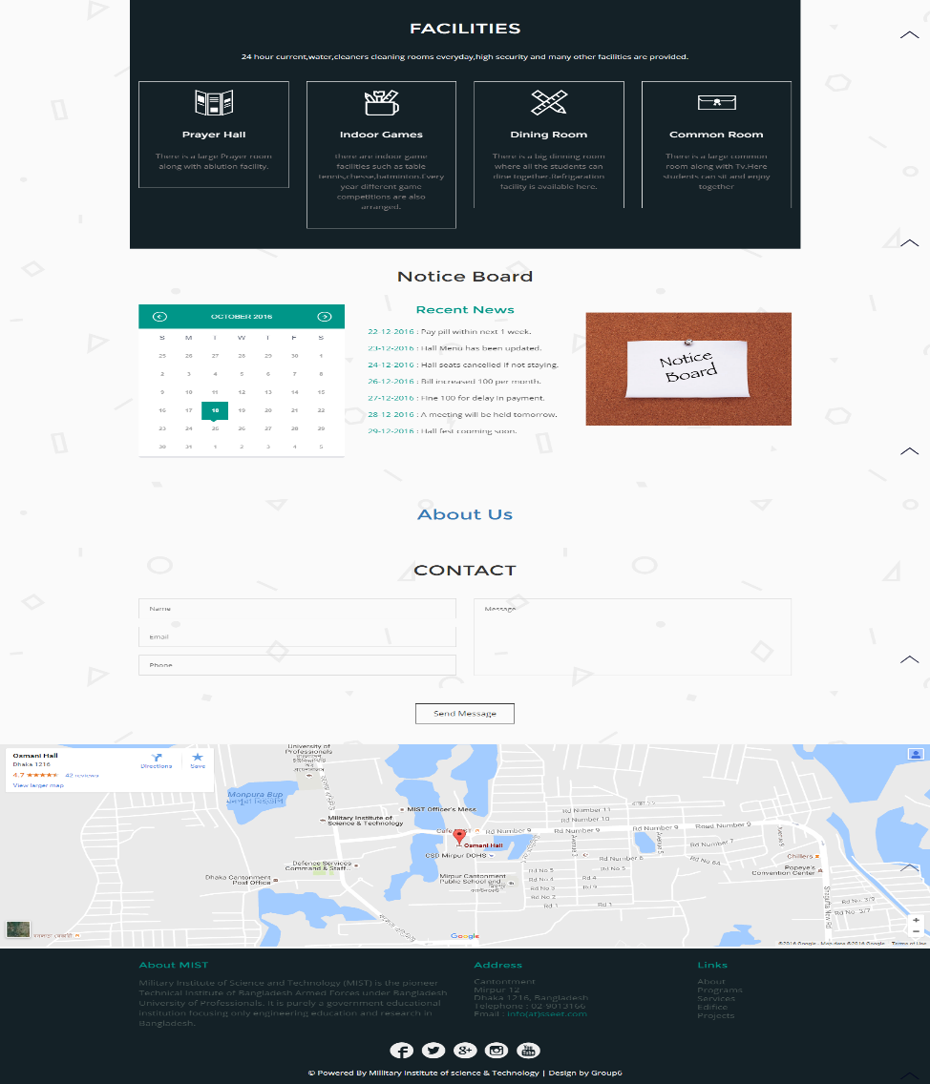
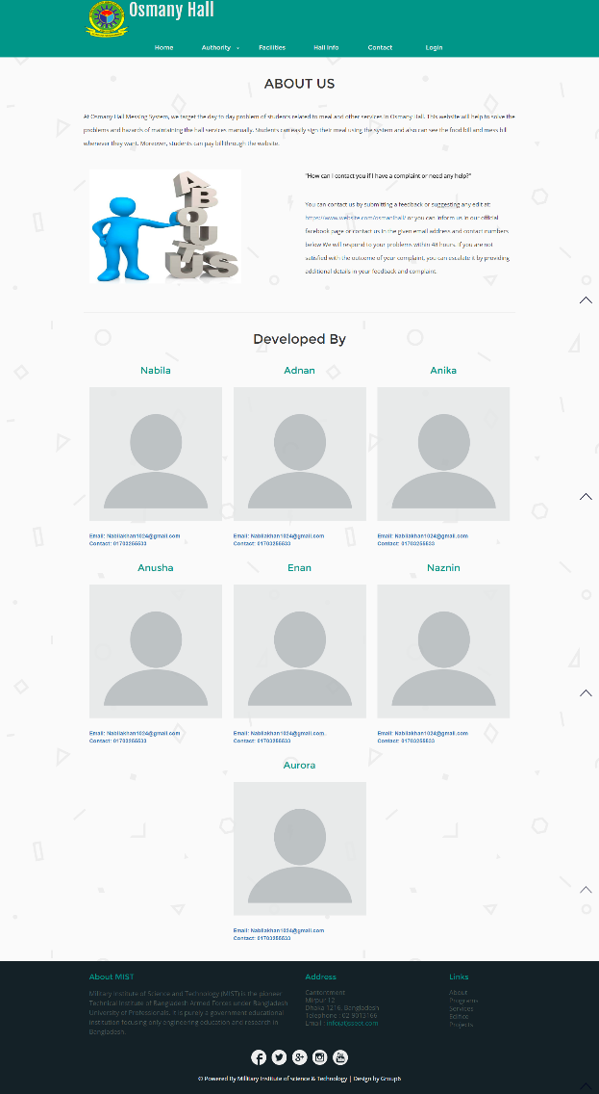
From home page to about us page transition

Slide 17
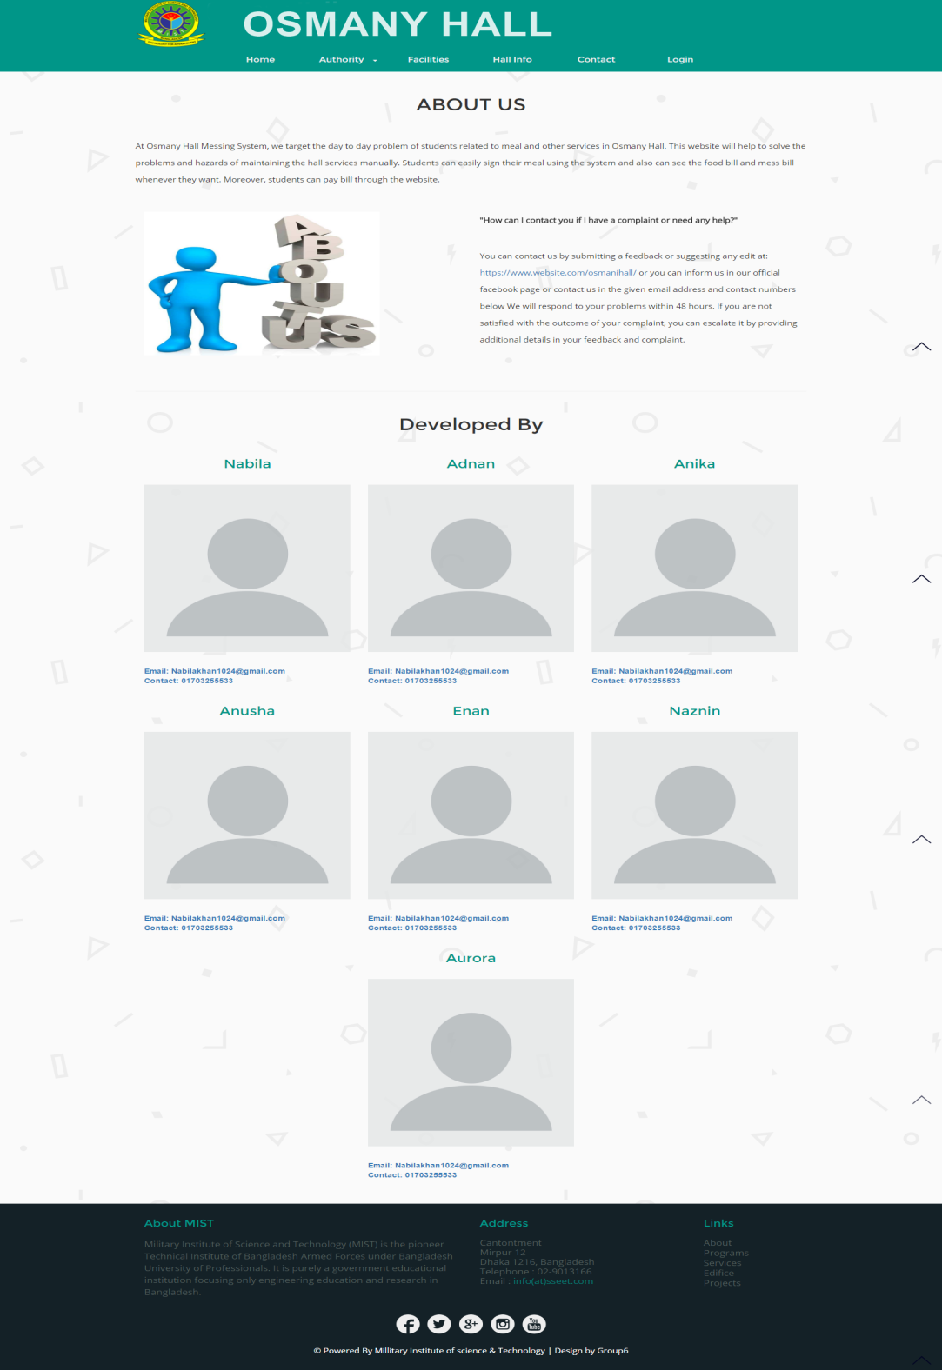
This page provides a short description of Osmany Hall Messing System and contact process as well as feedback giving method . Moreover this page contains
Information of developers.

Slide 18

Conclusion
We sincerely wish that the software we are about to create will ease out the hall life for students and also suffice the hall management committee to carry out necessary works in a smooth and reliable manner.

Slide 19
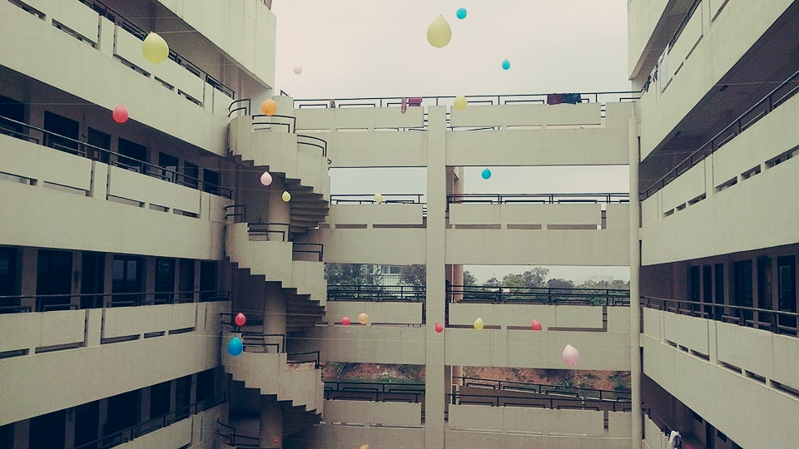
THANK YOU

Slide 20


